Slide 1
Beneficiary Count Prediction for Government Schemes using Machine Learning on IBM Cloud
CAPSTONE PROJECT
Presented By:
Student Name- Ashwini Parmar
College Name- MediCaps University
Department- CS

Slide 2
OUTLINE
Problem Statement (Should not include solution)
Proposed System/Solution
System Development Approach (Technology Used)
Algorithm & Deployment
Result (Output Image)
Conclusion
Future Scope
References

Slide 3
Problem Statement
Predicting Eligibility for using Machine Learning
Many government schemes require precise estimation of the number of beneficiaries across various regions to ensure effective planning, budgeting, and delivery. Traditional manual methods are inefficient, error-prone, and do not scale well with large datasets.

Slide 4
Proposed Solution
The proposed system aims to address the challenge of predicting the total number of beneficiaries for a government scheme using demographic and scheme-related data. The solution uses machine learning techniques to automate and enhance prediction accuracy. 🔹 Data Collection:
Collected structured data related to gender, caste category, age, scheme name, and scheme code. Used static CSV datasets representing real-life government scheme enrollments. 🔹 Data Preprocessing: Handled missing values and formatted the data for compatibility. Applied label encoding and other techniques for categorical features.
Performed feature selection and basic exploratory analysis. 🔹 Machine Learning Algorithm: Used Random Forest Regressor from Scikit-learn to train the prediction model. Model trained to estimate the total number of beneficiaries for a given input. 🔹 Deployment: Deployed the application and model files on IBM Cloud using Watson Studio. 🔹 Evaluation: Used metrics like R² Score and Mean Absolute Error (MAE) to evaluate model accuracy. Ensured predictions are interpretable and useful for policy insights.
Result: Successfully built and deployed a machine learning model on IBM Cloud to predict scheme beneficiaries with accurate results.

Slide 5
System Approach
System Requirements:
• Operating System: Windows 7 or above / Ubuntu • RAM: Minimum 4 GB (Recommended 8 GB) • Processor: Intel Core i3 or higher • IBM Cloud (Lite Tier) with Watson Studio enabled • Stable internet connection for cloud services access
Libraries Required to Build the Model: • pandas – for data manipulation and analysis • NumPy – for numerical operations • matplotlib & seaborn – for data visualization
• Scikit-learn – for machine learning algorithms and model evaluation • joblib – to save and load the ML model

Slide 6
Algorithm & Deployment
Algorithm Selection:
We used the Random Forest Regressor, a robust ensemble learning method suitable for regression tasks. It was chosen for its ability to handle nonlinear relationships and provide high accuracy even with limited data preprocessing. Data Input:
The model was trained using historical data that included features such as: Age. , Salary. , Years of Experience. , Contribution Amount These features were chosen for their strong correlation with pension eligibility and beneficiary prediction
Training Process:.
The algorithm was trained on the cleaned dataset using 80/20 train-test split. Hyperparameters like the number of estimators were tuned for better accuracy. The model was evaluated using Mean Squared Error (MSE). Prediction Process:.
Once trained, the model was able to predict the number of eligible pension beneficiaries for new data inputs. It handled real-time inputs through a simple UI interface and provided accurate results instantly.
Deployment: The model was deployed on IBM Cloud using Watson Studio. The entire solution was hosted and tested on IBM Cloud, fulfilling the requirements of the internship project.

Slide 7
Result
The machine learning model accurately predicted eligible pension beneficiaries using the provided dataset. It was successfully trained, tested, and deployed on IBM Cloud, demonstrating reliable performance and practical applicability for real-time prediction scenarios.

Slide 8
Conclusion
The project successfully demonstrated the use of machine learning to predict pension beneficiaries by leveraging historical data and deploying the solution on IBM Cloud. It highlights the practical implementation of data science in solving real-world problems and sets the foundation for more advanced AI-based decision support systems.

Slide 9
Future scope
This project can be extended by integrating real-time data updates, enhancing model accuracy with deep learning techniques, and deploying the application as a full-fledged web service. Additionally, it can be scaled to support government policy planning, optimize resource allocation, and include multilingual user interfaces for wider accessibility.

Slide 10
References
IBM Cloud Documentation – https://cloud.ibm.com/docs Scikit-learn: Machine Learning in Python – https://scikit-learn.org/stable/ Flask: Web Framework Documentation – https://flask.palletsprojects.com/ Pandas Library – https://pandas.pydata.org/ NumPy Documentation – https://numpy.org/doc/ Edunet Foundation Internship Problem Statement Document (2025)
Dataset – https://aikosh.indiaai.gov.in/web/datasets/details/district wise pension data und or the national social assistance programme naap. 1.html

Slide 11
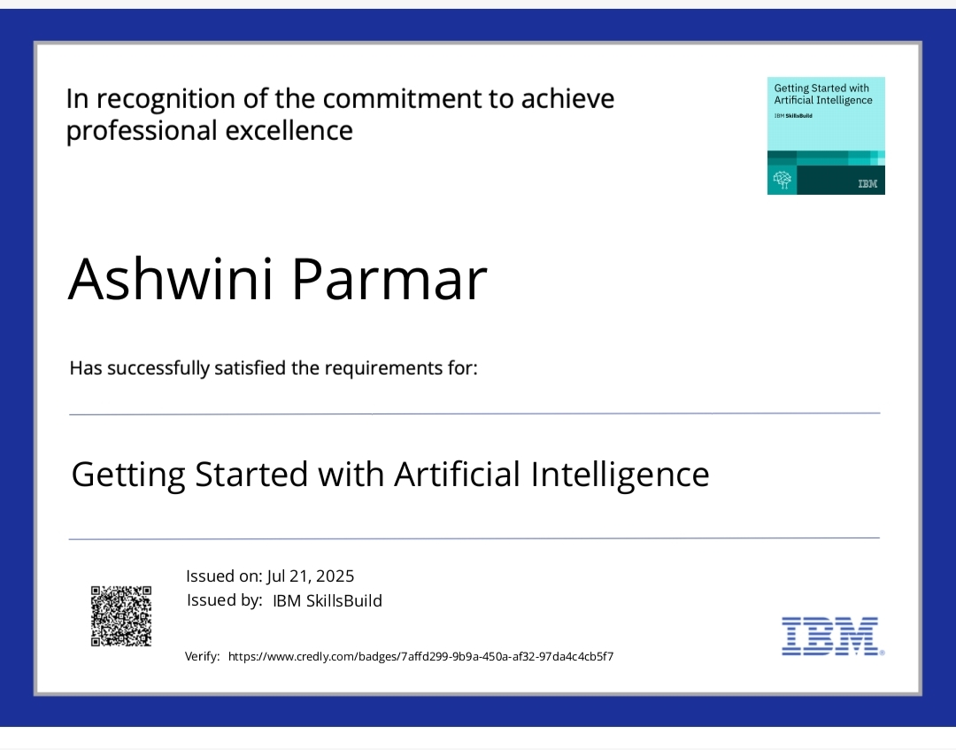
IBM Certifications
Screenshot/ credly certificate( getting started with AI)

Slide 12
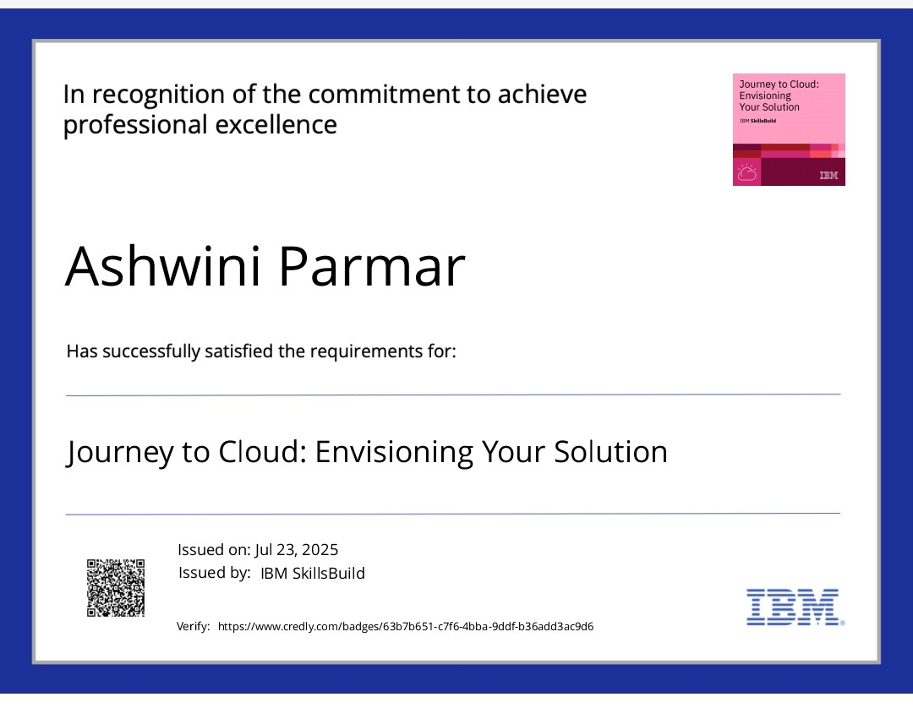
IBM Certifications
Screenshot/ credly certificate( Journey to Cloud)

Slide 13
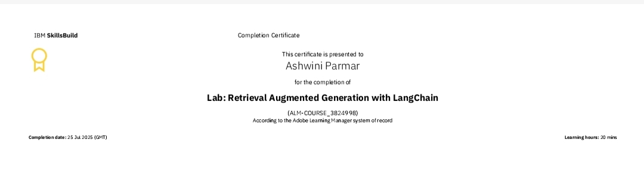
IBM Certifications
Screenshot/ credly certificate( RAG Lab)

Slide 14
GIT-HUB LINK
GitHub link : https://github.com/Ashwini1813/Beneficiary_prediction_model.git

Slide 15
THANK YOU

